Slide 1
Human Olfactory Mucosa Cells as a Model and Potential Tool for Biomarker Identification in Alzheimer’s Disease

Slide 2
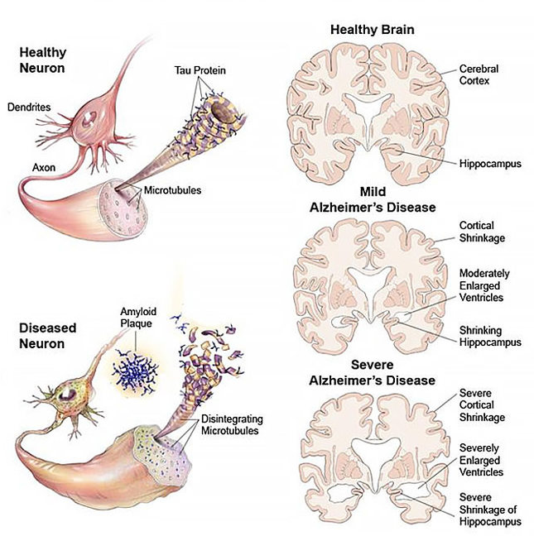
Alzheimer’s Disease is without a cure
Exact cause of neurodegeneration in majority of cases remains unclear
Familial and sporadic AD
131,5 million
46,8 million
2050
2015
https://www.brightfocus.org/alzheimers-disease/infographic/progression-alzheimers-disease

Slide 3

Symptoms of Alzheimer’s Disease Help needed in daily activities
Only medication relieving some of the
symptoms
https://www.ohsu.edu/brain-institute/understanding-alzheimers-disease

Slide 4
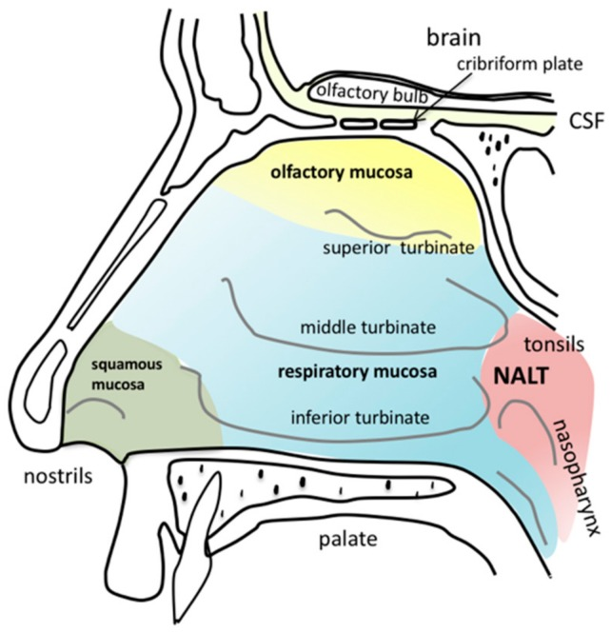
Olfaction and AD
Loss of smell early symptoms
Olfactory mucosa (OM) in direct contact with both environment and brain (olfactory bulb)
Sensory neurons travel through cribiform plate (bone with holes for neuron axons), connecting the OB and OM
Neurons of the OM regenerate throughout life
https://commons.wikimedia.org/wiki/File:Anatomy_of_the_human_nasal_cavity.png

Slide 5
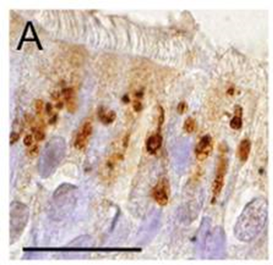
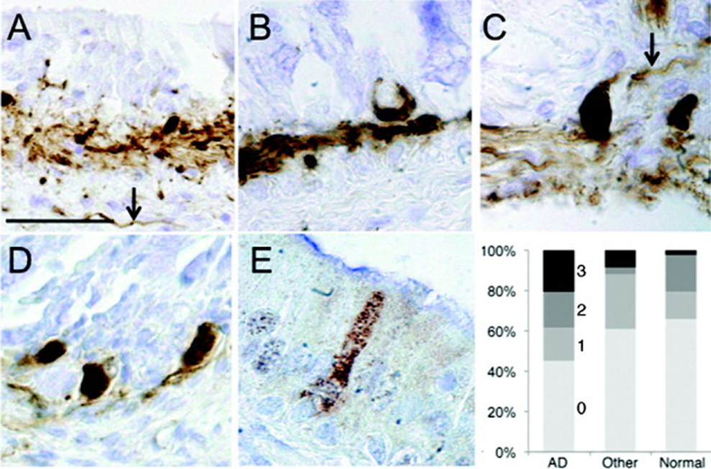
OM has also Aβ plaques and tau aggregates
Beta-amyloid plaques
Insoluble filaments of tau
https://www.ncbi.nlm.nih.gov/pmc/articles/PMC2864948/

Slide 6
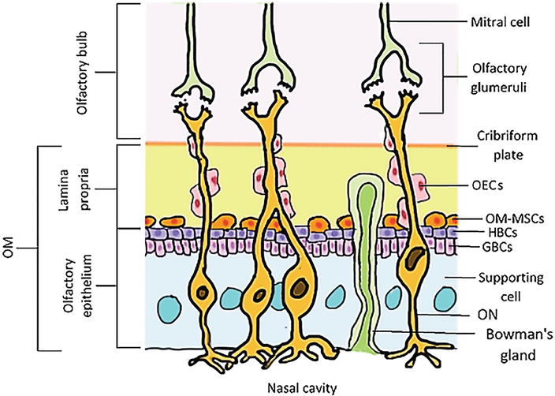
Cells of the olfactory mucosa
Cell model of the AD OM not published before
e.g. cells from patients with Parkinson’s disease or schizophrenia have shown disease-spesific alterations
DOI: 10.5772/intechopen.68174

Slide 7
MAIN AIM
Describing the novel cellular model for AD
AIM 1 AD-related functional changes in the AD OM cells
AIM 2 scRNA-seq to support the main aim
Beta-amyloid production
& secretion
Tau filaments
2A)
To identify possible biomarkers of AD and their validation (WB)
2B)
Characterize the cell populations in hOM cultures
Inflammation
Cytokines (CBA)
Ca. 10 control lines and 10 AD lines
Aim for publication in Nature Neuroscience (5-year Impact Factor: 21.403)
-Manuscript under preparation
Notes:
This project has two main aims: Characterize MCI and AD related functional alterations in cells derived from olfactory mucosa.
And to study the OM model for biomarker discovery and cell population characterization for MCI and AD via multiomics-approach. Both of these aims are ongoing at the same time.
To characterize possible functional alterations in cells derived from MCI and AD patients compared to cells derived from controls, we will study key pathological and cellular features linked in AD such as production of beta-amyloid , inflammation and oxidative stress. Mitochondria are important cell organelles competing against oxidative stress and they have also observed to accumulate toxic beta-amyloid during the disease with adverse effects on mitochondrial function. Thus we will include also some mitochondrial assays for cell functional characterization.
To study the potential of this model further and possibly identify new biomarkers for MCI and AD we will perform global RNA sequencing, DNA methylation analysis, non-targeted liquid chromatography-mass spectrometry profiling of metabolites and single-cell RNA sequencing of these cells. The single cell sequencing will also provide us valuable information of different cell populations present in these samples and the potential of stem cell enrichment.
Finally, we will also compare our single cell and global RNA-seq results to recent recent finding published from post mortem AD brains.

Slide 8
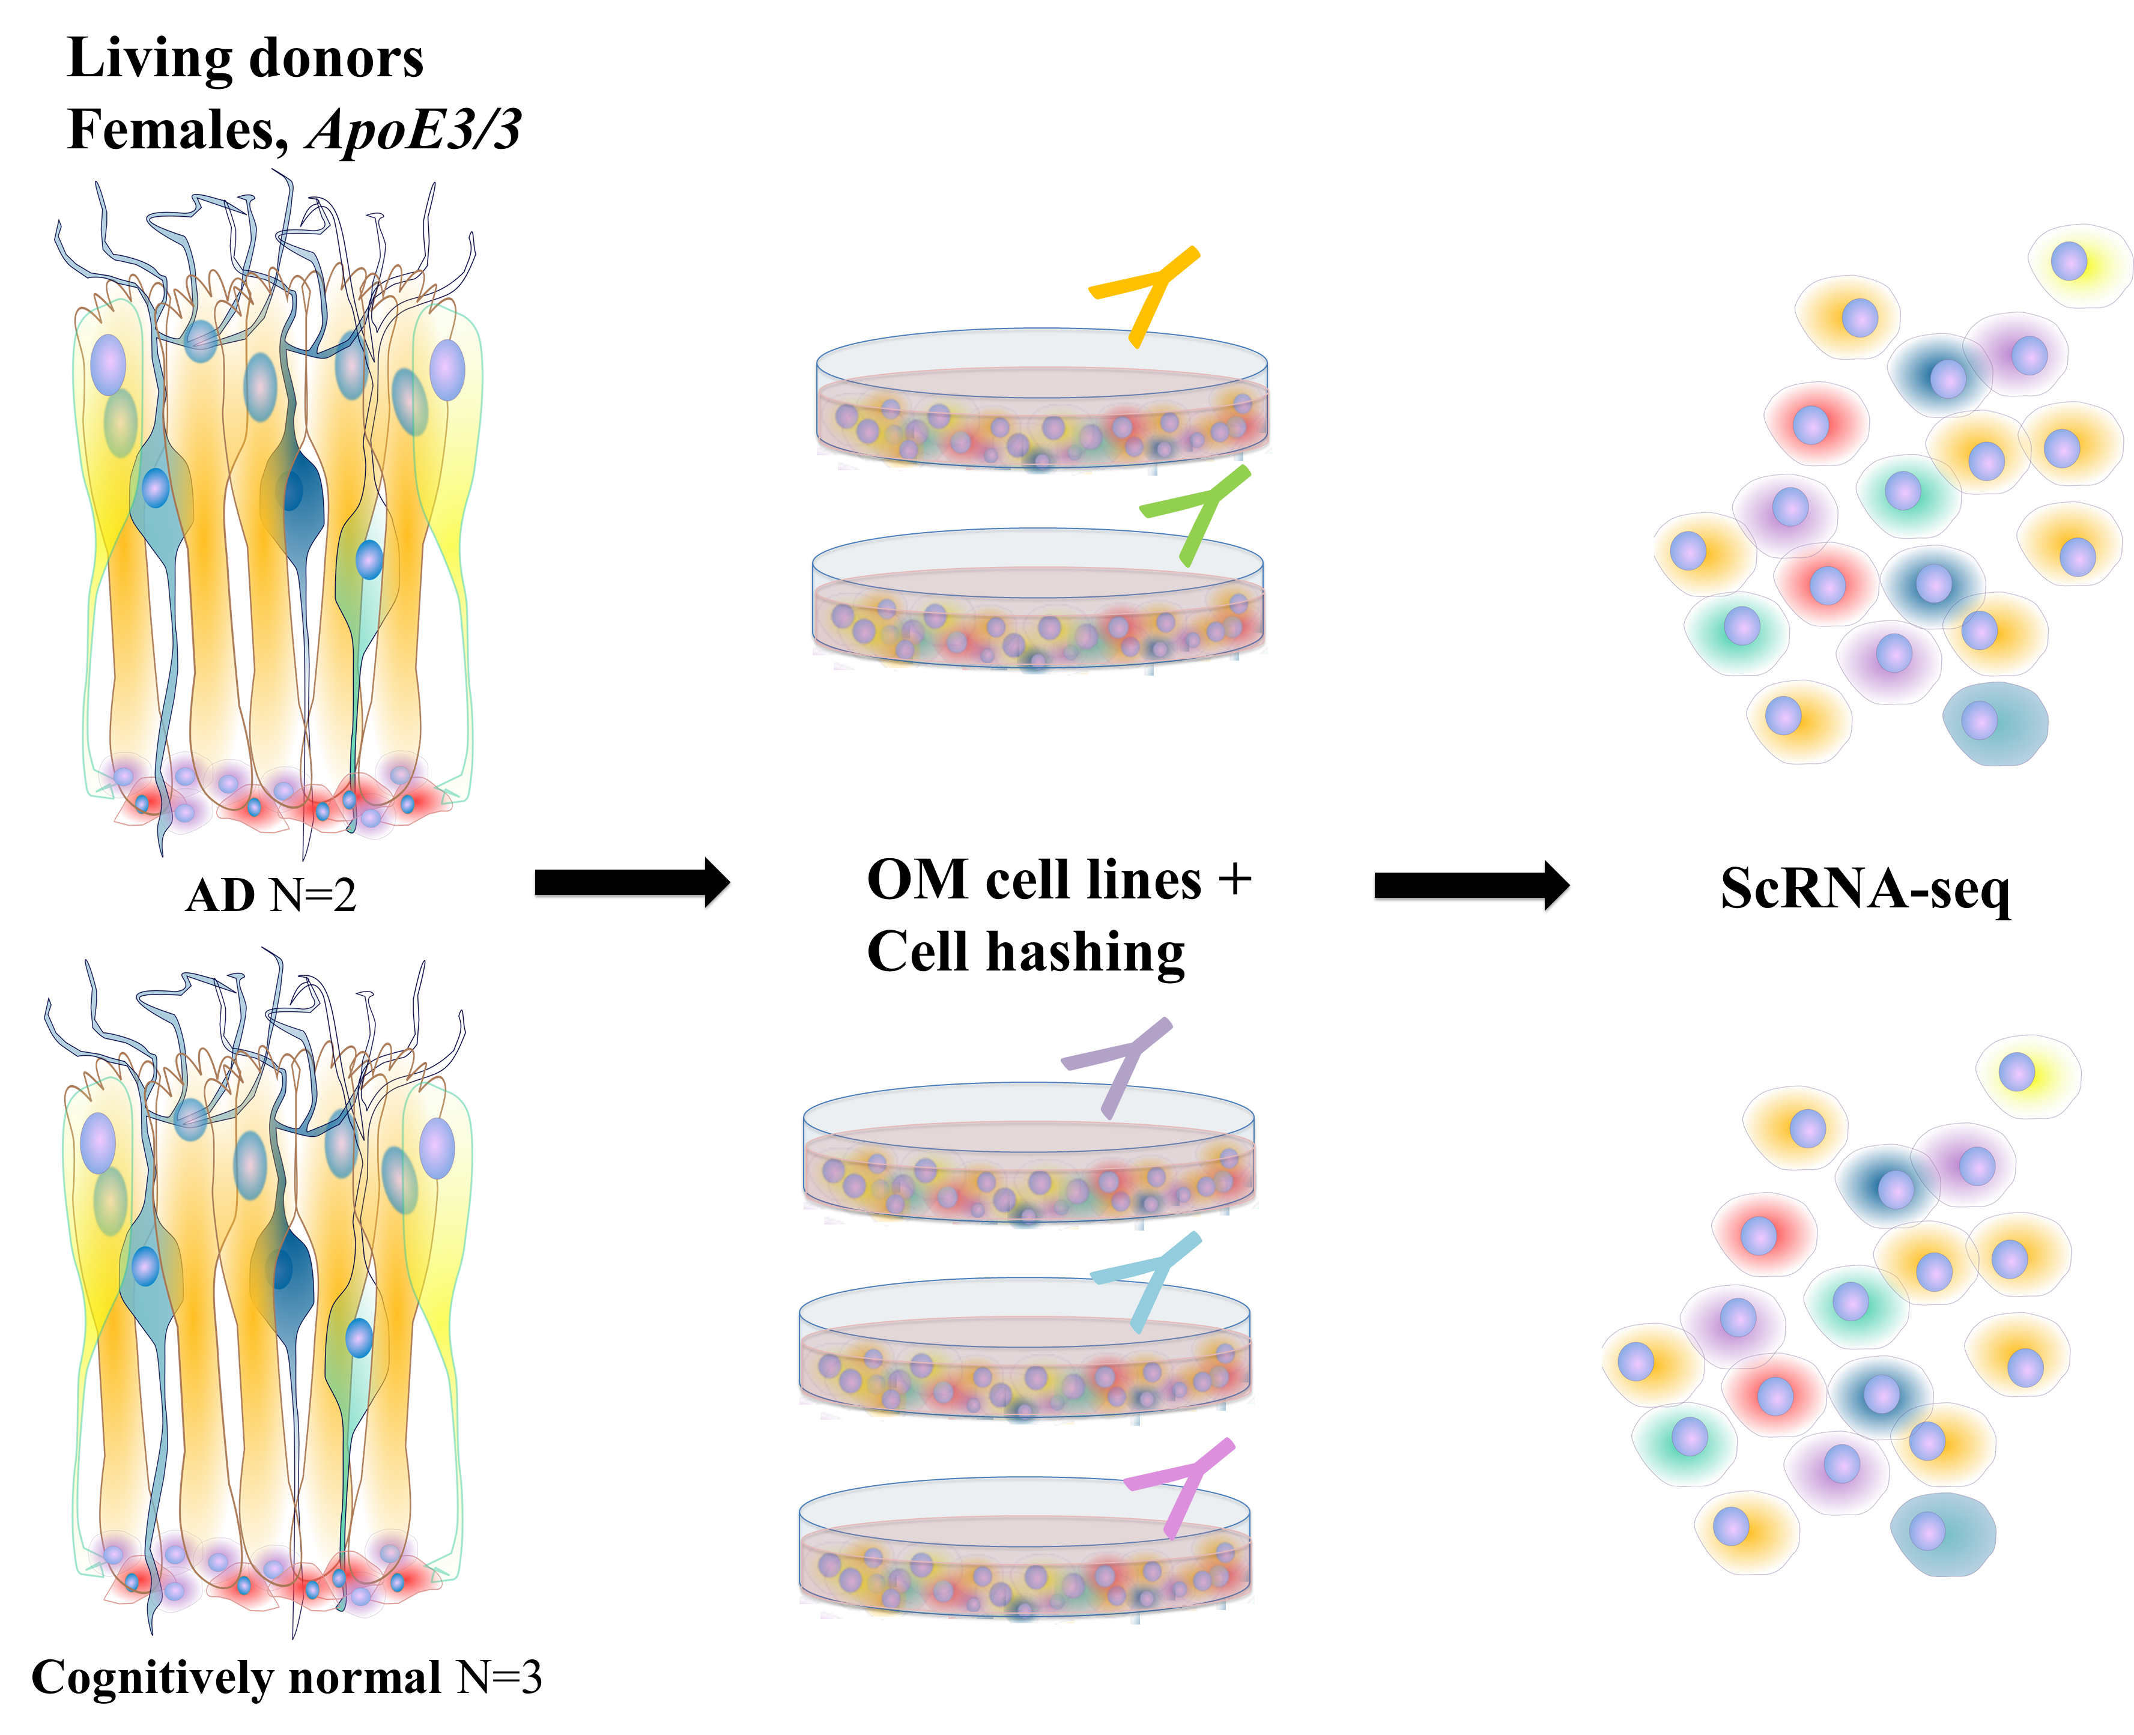
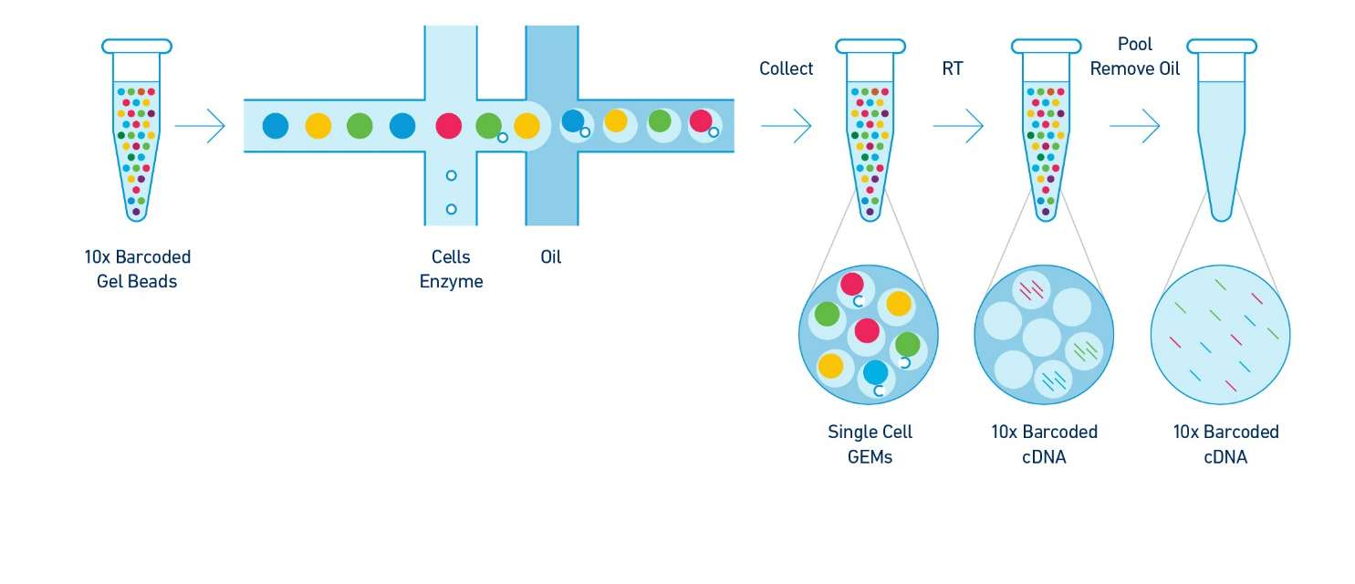
Starting material for scRNA-seq
12,582 cells
Median 3,336 genes/cell
10x Genomics
Chromium Single Cell 3' Reagent Kit
v3 chemistry
10,816 cells
Median 4,066 genes/cell

